Slide 1
Numerical Methods Lec 6
By
Asst. Prof. Syed Shujaat Hussain

Slide 2
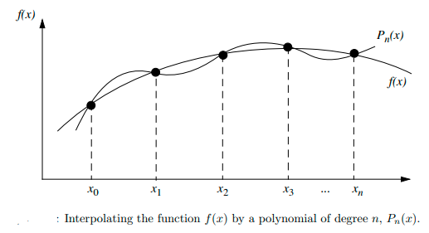
Polynomial Interpolation
Let f(x) be given at the selected sample of (n + 1) points: x0 < x1 < · · · < xn,
i.e., we have (n+1) pairs (xi, fi), i = 0, 1, 2, . . ., n.
The objective now is to find the lowest degree polynomial that passes through this selected sample of points.

Slide 3
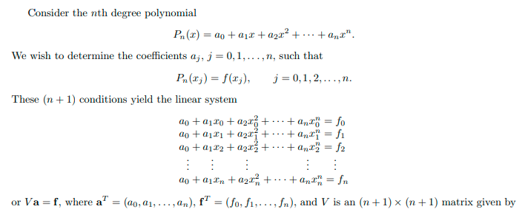
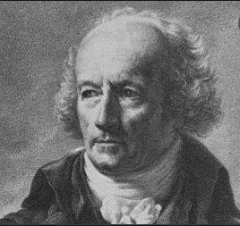
Vandermonde Approach
Vandermonde
(28 Feb 1735 – 1 Jan 1796)
French mathematician, musician and chemist

Slide 4

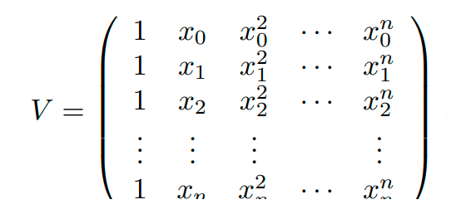
Summary
The matrix V is known as the Vandermonde matrix.

Slide 5
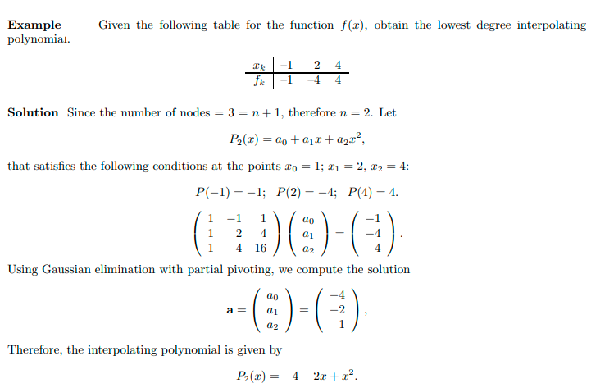


Slide 6
Class Activity
Q Obtain a polynomial by Vandermonde approach. Which passes through (1,2), (2,3) and (4,11)

Slide 7

Solution
We Know that
$$P\left(x\right)=\sum_{0}^{2}{aixi}$$
$$P\left(x\right)=a0+a1x+a2x2$$
$$a0+a1+a2 =2$$
$$a0+2a1+4a2 =3$$
$$a0+4a1+16a2 =11$$
$$a0=3 , a1=−2 , a2 =1$$
There fore required equation will be
$$3−2x+x2 =0$$

Slide 8
Test your ability!
Q Obtain a polynomial by Vandermonde approach. Which passes through (1,1), (2,4) and (4,5)

Slide 9

Solution
$$P\left(x\right)=\sum_{0}^{2}{aixi}$$
$$P\left(x\right)=a0+a1x+a2x2$$
$$a0 + a1+a2 =1$$
$$a0 + 2a1+4a2 =4$$
$$a0+4a1+16a2 =5$$
$$a0=−11/3 , a1=33/6 , a2 =−5/6$$
There fore required equation will be
$$−\frac{11}{3}+\frac{33}{6}x−\frac{5}{6}x2 =0$$

Slide 10
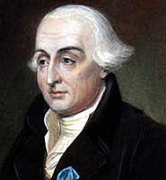
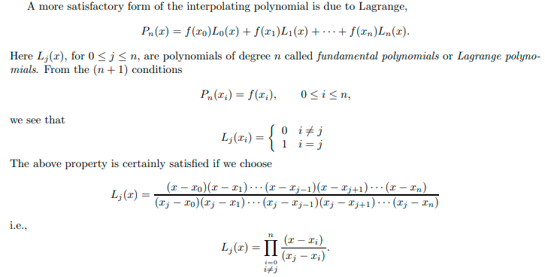
Lagrange Approach (1736-1813)

Slide 11
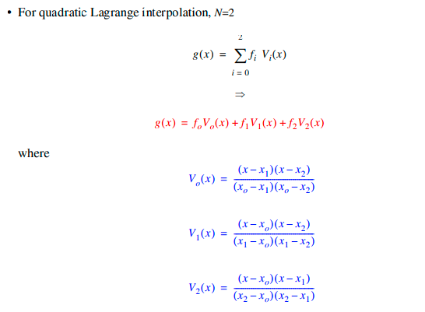
Example: Lagrange Quadratic Interpolation Using Basis Functions
X₁ and X₂ are root of Ploy.
X= X₀ V₀(X₀)=1
X₀ and X₂ are root of Ploy
X₀ and X₁ are root of Ploy

Slide 12
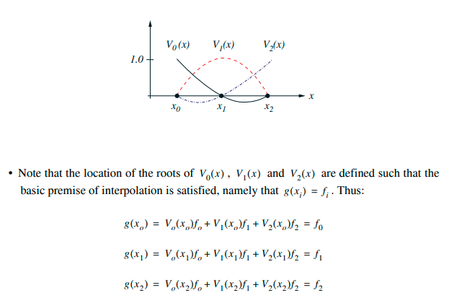

Slide 13
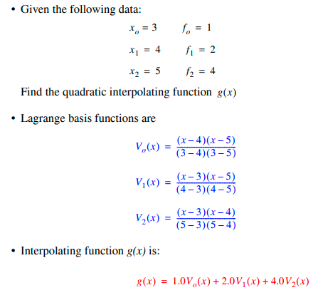
Example: Construct a Lagrange interpolation polynomial passing though (3,1),(4,2) and (5,4)

Slide 14
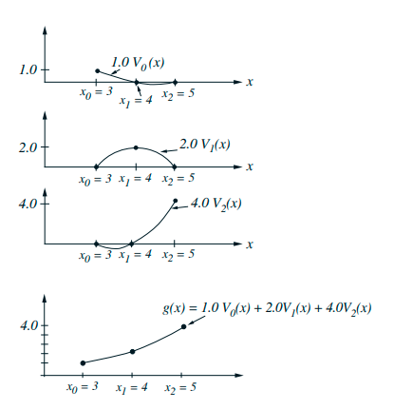
Graphically

Slide 15
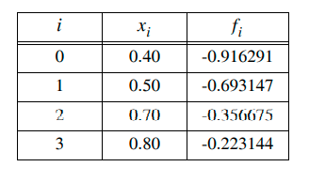
Class Activity Q: Find the Lagrange Polynomial for the following Q: Find g(0.6)

Slide 16
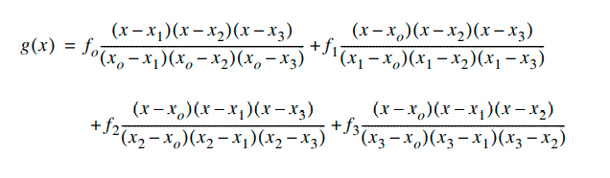
Solution

Slide 17
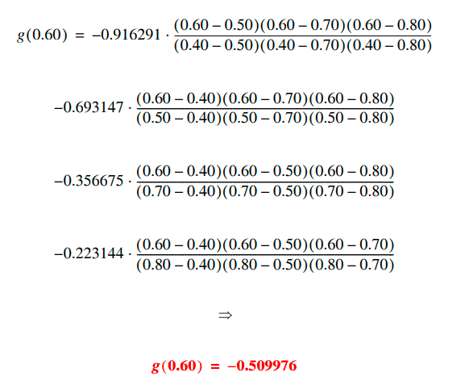
Solution

Slide 18
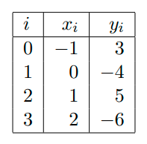
Class Activity
Q Use Lagrange interpolation to find the unique polynomial P₃(x), of
degree 3 or less, that agrees with the following data:
Also calculate P₃(1.5).

Slide 19
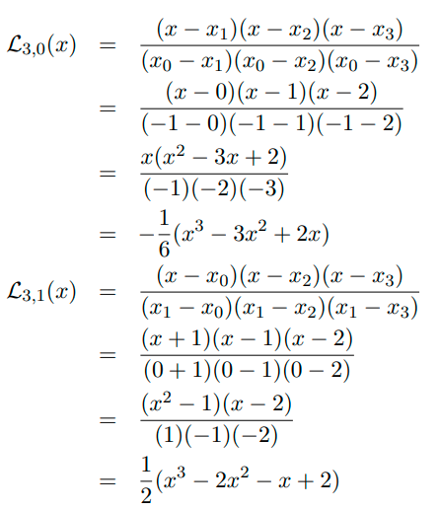
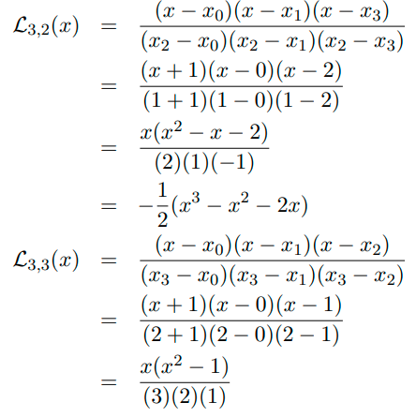

Solution

Slide 20
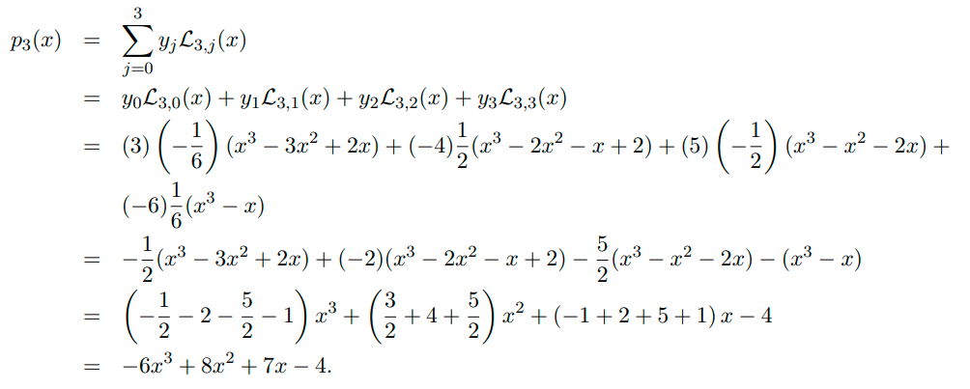
Finally Lagrange Polynomial from required points will be
P₃(1.5) = 4.25

